Slide 1
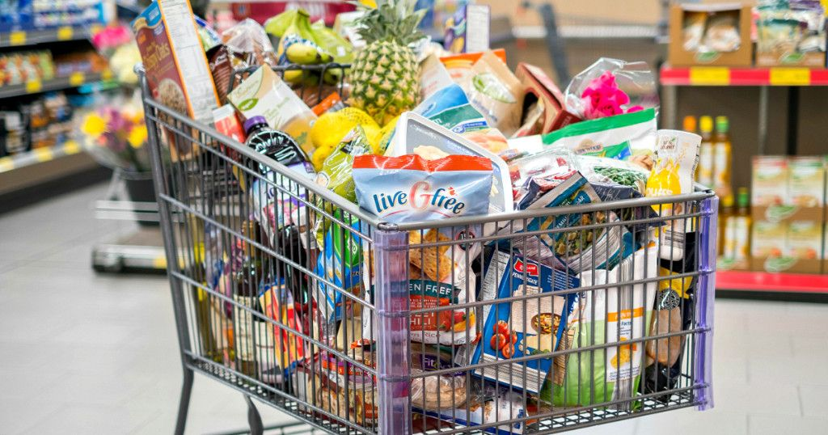
SHOP
Grocery Store Management System

Slide 2

ABOUT US
Welcome to E-store your trust worthy website where we offer a shop/delivery service for groceries.
Customers buy your products from our website.
We shop in-store/delivery using a system.
To make the service fast/cheap for customers we need to form a partnership.

Slide 3
OUR SERVICES
Authentication : Handles user signup/login.
Dashboard : Manages item data , account data and retrieval.
Orders : process orders from front end and persist to database

Slide 4
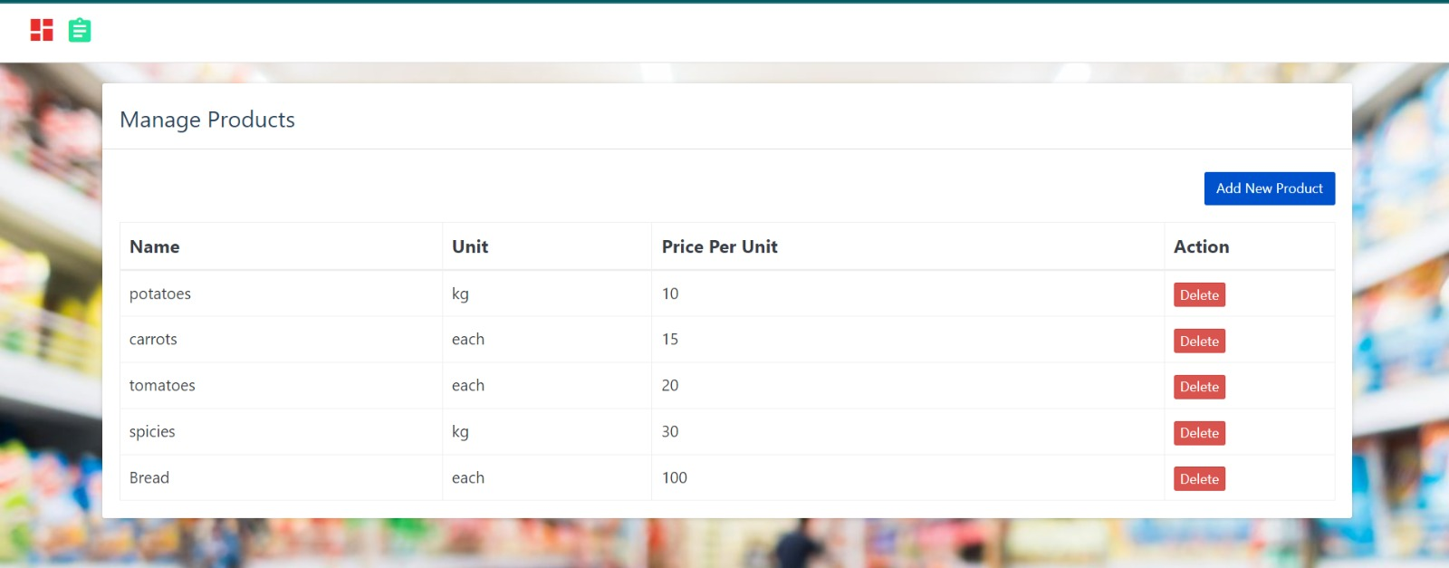

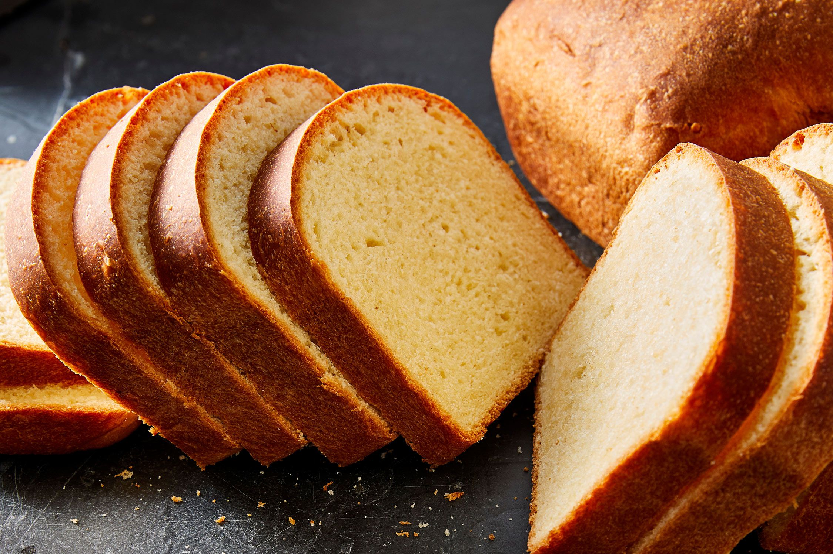
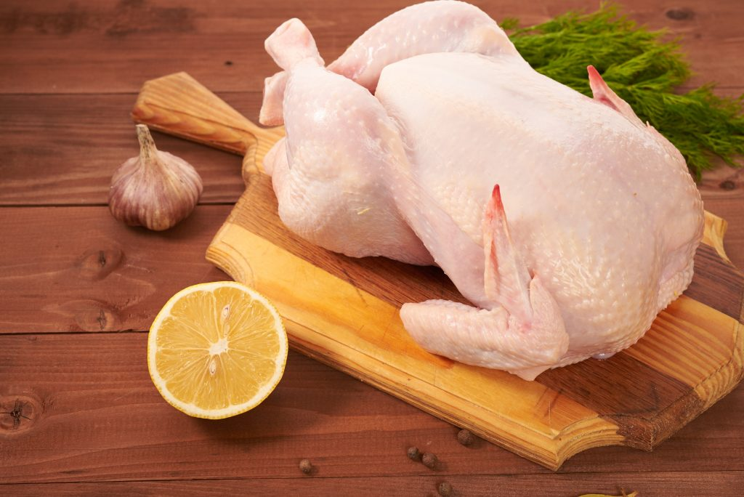
OUR PRODUCTS
Tomato
Bread
Chicken

Slide 5
This is the manage product interface, that allows the admin to remove, add or update products in the system. It displays the products, their unit of measurement and their price per unit At the top left corner you have the dashboard option
Dashboard
Add product
Delete Product

Slide 6
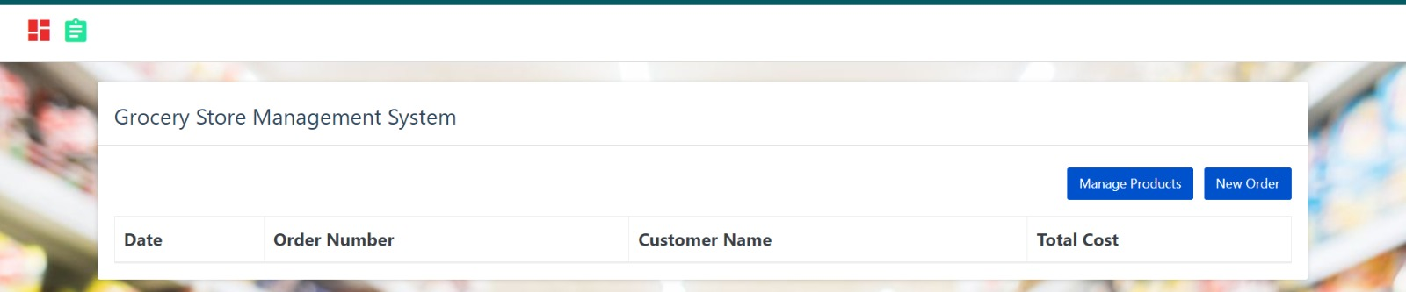
here the information on delay order management is shown. Each time a customer places an order the admin or employee will mange his orders from here

Slide 7
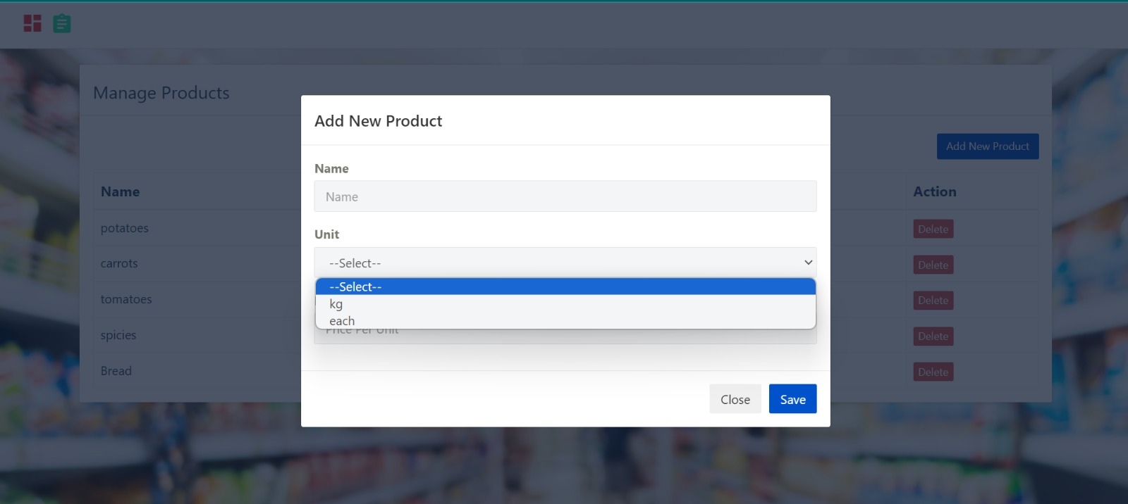
When a new product is to be added to your system, after clicking on add new product, it will provide you with a window where the Name and unit of measurement of the product is selected.

Slide 8
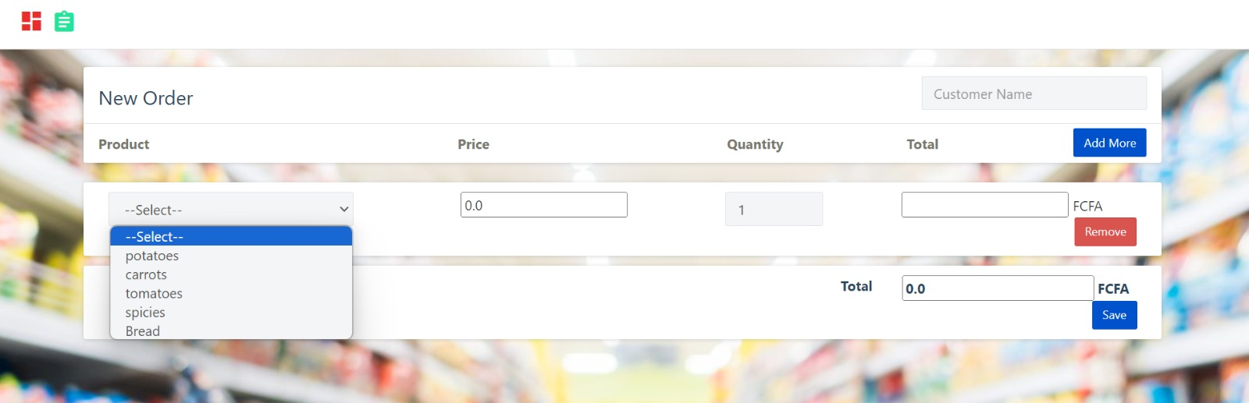
This is the interface where a new order is created in the system . The customers orders are enterd so as to come out with the total amount of money to be paid

